Slide 1
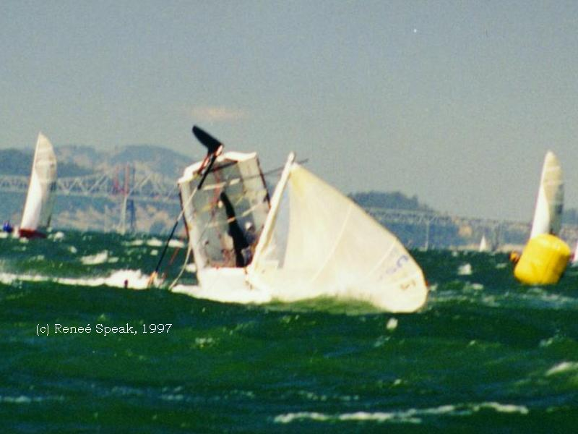
Learning To Sail

Slide 2
Goals
Preparing for your trip
Planning your trip
Getting Around
Emergency
Encountering other boats

Slide 3
Preparing
This is the most vital element in sailing
Preparing for any circumstance will drastically improve your situation
  Weather (forecast, temperature)
  Location Conditions
  Equipment
  Crew Accommodations

Slide 4
Weather
Always check forecast
  While not 100% accurate, usually very close
Watch clouds for storms
Watch the wind
If a thunderstorm approaches, head for the nearest shore
If caught in the middle of the lake, capsize
Watch for extreme temperatures and high winds

Slide 5
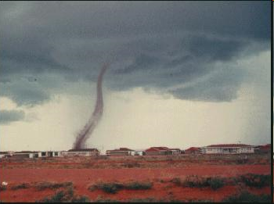
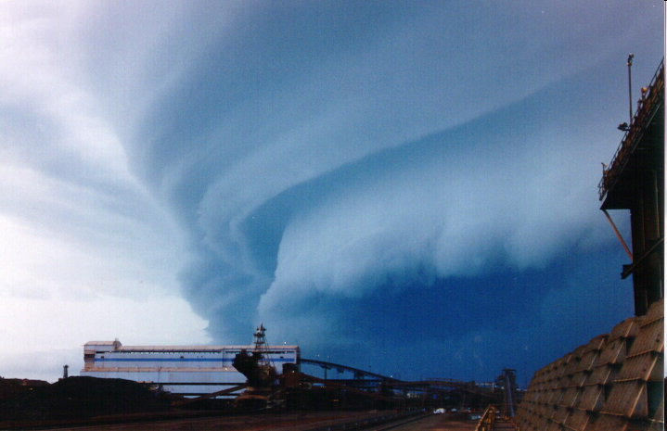

Slide 6
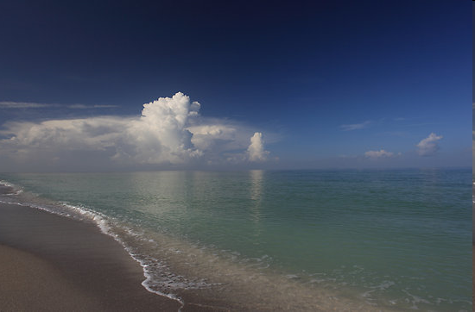
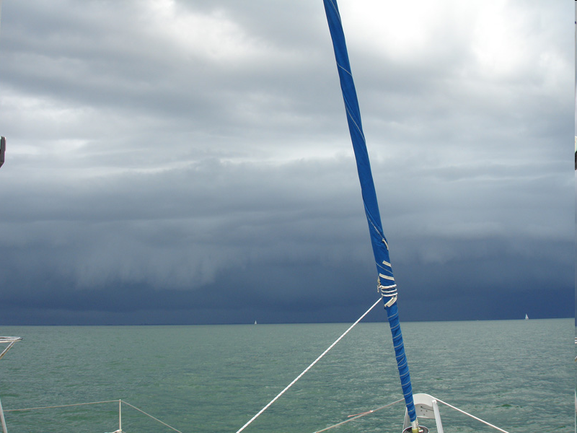

Slide 7
Preparing- Clothes
As we discussed previously- Plan ahead
Have more clothes than you think you need
  Using layer helps adjust if you’re too hot/cold
Wear appropriate gear
  Example: make sure you have something that keeps out water/wind, don’t wear cotton, jeans, sandals in winter

Slide 8
Hypothermia
Can result from cold air, water, or both
Signs and Symptoms:
  Shivering
  Numbness
  Glassy Stare
  Confusion
  Weakness
What do you do?
  Remove ALL wet clothing
  Gradually warm person up

Slide 9
Heat Exhaustion
Can be caused by heat and/or a lack of water intake
Signs and Symptoms:
  Cool, moist, pale skin
  Headache
  Nausea
  Dizziness and weakness
  Exhaustion
  Dilated pupils
What to do?
  Move person to cool location
  Loosen or remove clothing
  Apply moisture to skin
  Drink cool water in moderation

Slide 10
Heat Stroke
Can be Life Threatening!
Signs and Symptoms:
  High body temp
  Dry skin (stopped sweating)
  Constricted pupils
  Rapid, shallow breath
What to do?
  Move person to a cool location
  Contact EMS
  Cool person rapidly by immersion in a cold bath
  Do not give anything to eat or drink

Slide 11
Planning Your Trip
Be aware of Conditions
  Wind direction (keep track all day)
  Dangerous areas
    Shoals
    Docks/Marinas
    Currents
    Channels
Anticipate Dangers
  Where is the wind/current trying to push me?
  How can I proactively avoid being in a difficult situation?

Slide 12
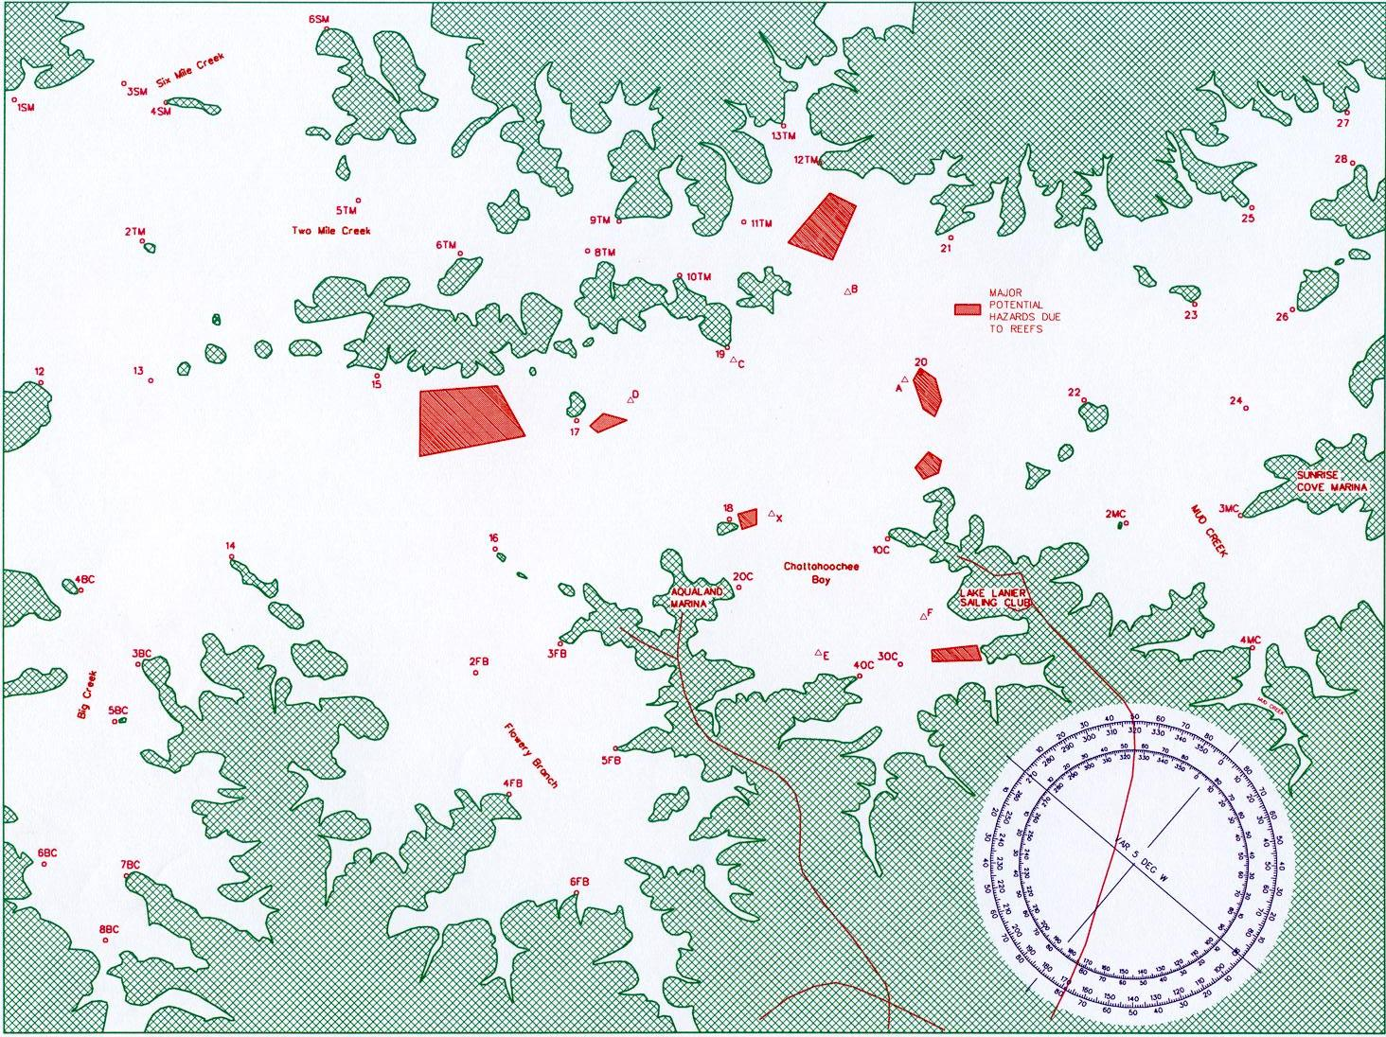

Slide 13
Emergencies
Prepare ahead
  Check gear/equipment
  Mentally think of what could happen given what you know (high wind? How will you avoid danger?)
Ensure crew is comfortable/informed on procedures

Slide 14
Man Overboard- pg 58
Let everyone know
Throw a flotation device
Make a plan
Approach the person slowly with them to windward of the boat
A jibe to get back is dangerous in heavy air

Slide 15
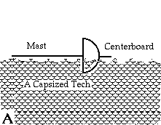
Capsize
Is everyone OK?
Do NOT swim under the boat

Slide 16
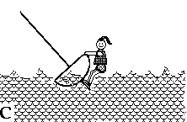
Righting the Boat
Uncleat all sails
Turn the bow into the wind
Lean back and be patient
If needed, grab a jib sheet
Wind

Slide 17
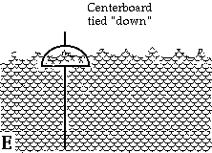
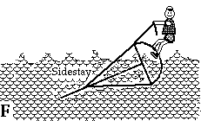
Capsize - Turtle
Throw a jib sheet over the boat
Stand on the gunwale and lean back
OR, hold centerboard with both hands

Slide 18
Encountering Other Boats
Right of Way
  Mean you have the Right to continue making Way
  You may hold your course (stand-on vessel), not a free pass
Most important ROW rule: ALWAYS AVOID COLLISION
Rules are in place to clarify who must alter course (give-way vessel), but never assume everyone knows them.
When in the right, hold your course until it is blatantly obvious you must do otherwise.

Slide 19
Hierarchy
Swimmers/people in water (watch for dive flags)
Man-powered boats (canoes/kayaks)
Sailboats
Powerboats/motorboats
Generally, larger (faster) vessels give way to smaller (slower) vessels
***Large commercial vessels trump everything (inability to avoid collision)

Slide 20
Hierarchy
Among Sailboats, more rules exist
  Sails and a boats tack determine rules
Rules:
  Overtaking vessel gives way
  Starboard tack over port tack
  Leeward over Windward

Slide 21
Overtaking boat gives way

Slide 22
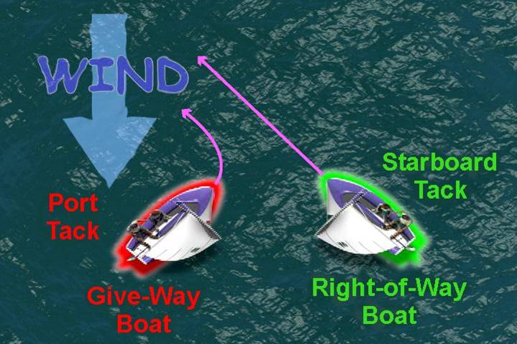
Starboard over port

Slide 23
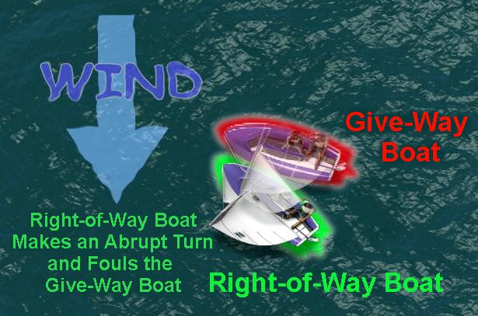
Windward over Leeward

Slide 24
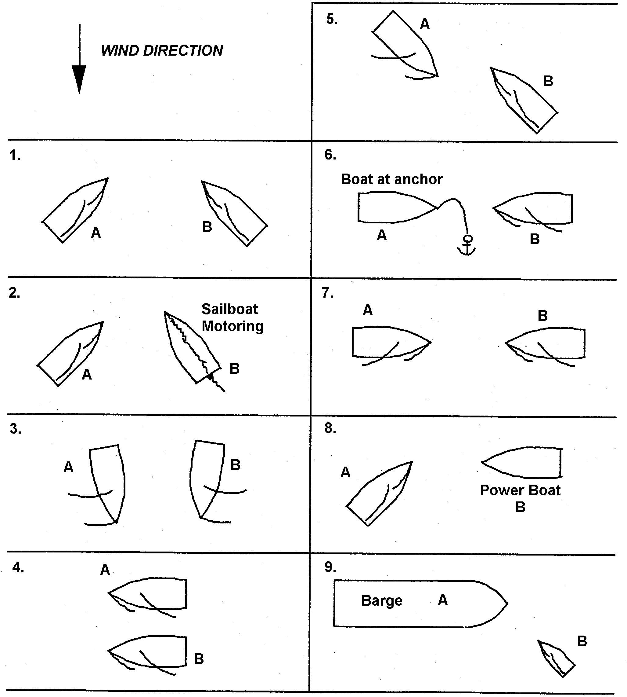

Slide 28
Questions?
Clinic will be on Sunday
Meet at CRC at 10:30

